Slide 1
ROCO218: Control Engineering Dr Ian Howard Lecture 9 1st order systems

Slide 2
Response of 1st order system
Consider a 1st order differential equation system
Taking Laplace transforms

Slide 3
Response of 1st order system
From
We now drive the system by a unit step function starting at t=0
Therefore f(t) is a constant =1
Ignoring initial conditions the response is therefore

Slide 4
Response of 1st order system
From
Writing in the form
Where τ is the time constant
Re-writing as partial fractions
Equating coefficients

Slide 5
Response of 1st order system
Therefore
From Laplace pairs table we see that
Thus the inverse Laplace transform gives the time solution

Slide 6
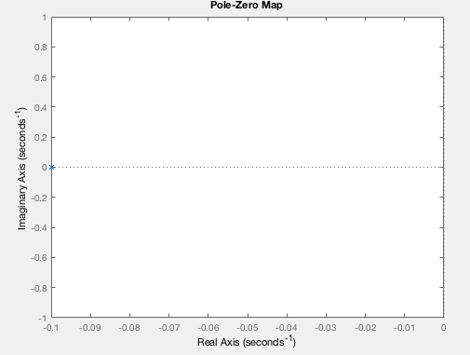
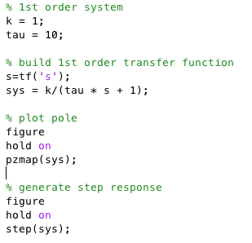
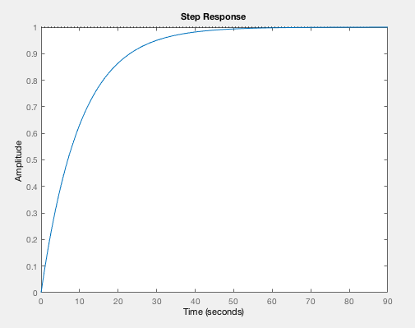
1st order system pole Matlab simulation

Slide 7
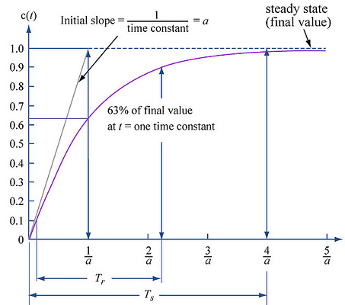
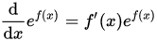
1st order system time response
We see 1st order system has the time response to a step given by
Where
k is the system gain
τ is the system time constant
If we set time t= τ then
Thus the time constant is the time taken to reach 63.2% of maximum change. Note also
Thus initial slope at t=0 is

Slide 8
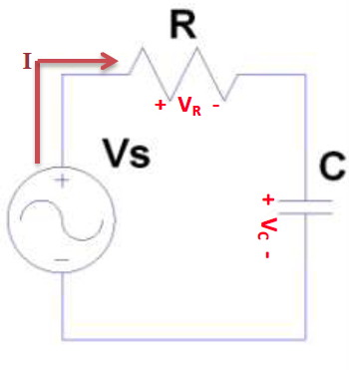
Remember: Voltages in an RC circuit
Adding up voltages
Ohms law
Current proportional to
rate of change of charge
Substitute I from
capacitor expression
Rearranging gives
This is a first order linear differential equation

Slide 9
RC circuit time constant
From
Taking Laplace transformation with zero initial conditions
Collecting V_{c} terms together
Multiply though by RC

Slide 10
RC circuit time constant
From
Driving using a step of voltage V at t=0
Where time constant τ = RC
From general case before the inverse Laplace transform gives the time solution

Slide 11
RC circuit current
From
And
Since

Slide 12
RC circuit current
From
Collecting current terms together
Taking Laplace transformation with zero initial conditions

Slide 13
RC circuit current
From
Driving using a step function if voltage V at t=0
Where time constant τ = RC
From Laplace pairs table we see that

Slide 14
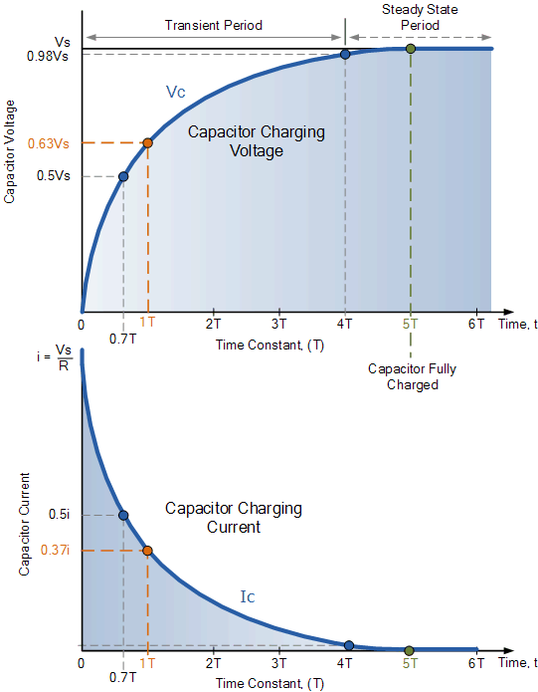
RC circuit voltage and current Time constant
The time constant τ is related to the cutoff frequency f_{c}

Slide 15
Relationship between rise time & BW for 1st order system
For the series RC circuit, capacitor voltage is given by
Can calculate frequency response by substituting s = jω
Now write
Where f_{bw} will be the -3dB bandwidth in Hz
If we let
So when input frequency is f_{bw} the response drops by 3dB

Slide 16
Relationship between rise time & BW for 1st order system
We saw that the voltage across capacitor in response to step given by
Where time constant τ = RC
And the inverse Laplace transform gives
Rise time t_{r} is time between reaching 10% and 90% - will discuss more shortly
These times are respectively given by

Slide 17
Relationship between rise time & BW for 1st order system
So we see that
From before we can also write
Where f_{bw} is the -3dB bandwidth in Hz
This gives a rule of thumb for the relation between bandwidth and rise time for 1st order systems

Slide 18
ROCO218: Control Engineering Dr Ian Howard Lecture 9 2nd order systems

Slide 19
Response of 2nd order system
Consider 2nd order response behavior described by the differential equation
Taking Laplace transforms
Factorizing out X(s)

Slide 20
2nd order system canonical form
Transfer function of the 2nd order system is
Writing in canonical form is informative because we can then directly identify:
W_{n} which is the natural frequency of the system
ξ which is the damping ratio of the system
Writing in canonical form
Poles occurs when denominator is zero

Slide 21
Remember: Solving quadratic equations
The quadratic equation
Has the solution
if
The solution will be a real number
if
The solution will be an imaginary number

Slide 22
2nd order system canonical form
Solving for denominator poles
for
Square root term negative so get complex result

Slide 23
2nd order system canonical form
The time response of a 2nd system depends on the value of damping factor ξ and natural frequency W_{n}
For
Real solution and system is over-damped
The solution is stable and has –ve real poles
Exhibits exponential decay
For
Real solution and system is critically damped
For
System is under-damped
The solution is stable and has complex poles and exhibits oscillatory decay
For
System is un-damped
Continuous oscillation
So marginally stable
For
System is unstable!
System exhibits unlimited growth

Slide 24
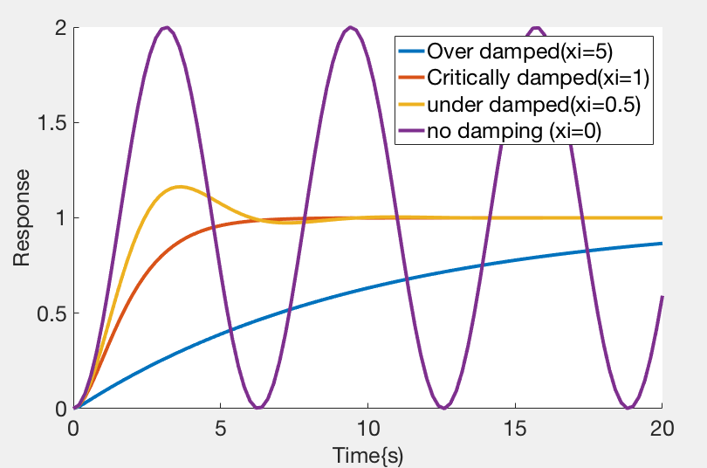
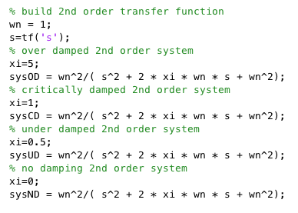
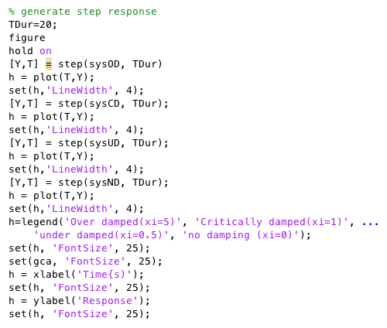
2nd order step response Matlab simulation
When ζ < 1 response under damped and sinusoidal
As ζ increases response becomes progressively less oscillatory
When ζ=1 response critically damped
When ζ>1 response over damped for.
Control systems normally designed with a damping factor ζ<1

Slide 25
2nd order system analytical step response
Starting with the transfer function
Assuming zero initial conditions the step response given by
Partial fraction expansion and inverse Laplace yields

Slide 26
2nd order system analytical step response
Note following points
Damped oscillatory frequency
Time constant
Natural frequency
Damping

Slide 27
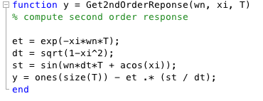
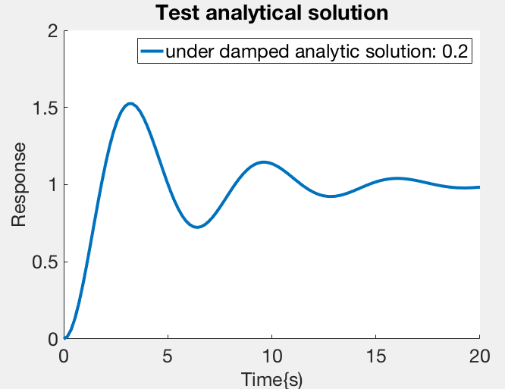
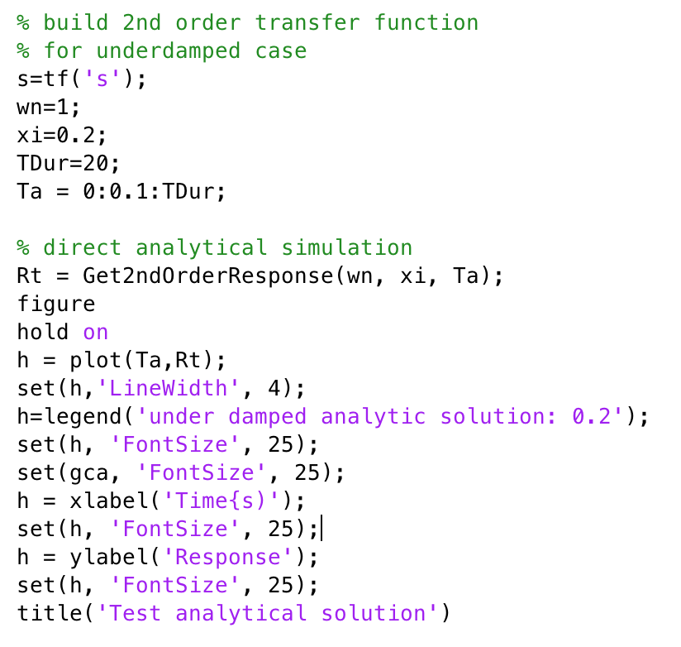
2nd order system analytical step response

Slide 28
ROCO218: Control Engineering Dr Ian Howard Lecture 9 Example canonical 2nd order system

Slide 29
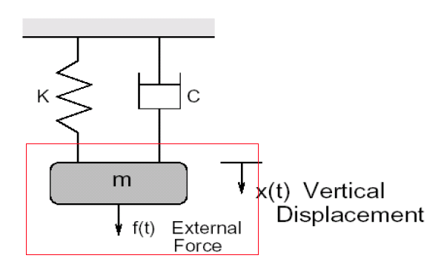
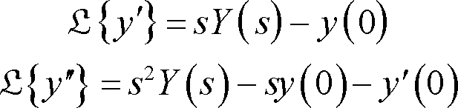
Spring mass damper system: Differential eqn
From differential equation of movement
Let us now predict system response
Remember in the general case the Laplace transform of differentials include initial conditions
Taking Laplace transforms of mass-spring-damper system gives

Slide 30
Spring mass damper system: Laplace representation
From Laplace equation
Consider case where
We pull down the mass
We hold still
Then we release at t=0
Start at x₀
Not moving
No external force

Slide 31
Spring mass damper system: Transfer function
So given
At x₀
Not moving
At x₀
Substituting in initial conditions
Rearranging to factor out X(s)
Gives

Slide 32
Spring mass damper system: Canonical form
To write in a canonical form
We need to have a unity s² term so
By inspection we see that
So
The natural frequency of the system
The damping ratio of the system

Slide 33
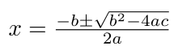
Spring mass damper system: Zero and poles
The characteristic equation
Has a zero when the numerator goes to zero
This happen when
For ξ² < 1 there are poles when the denominator goes to zero
This happens when
Remember for equation:
Solution:

Slide 34
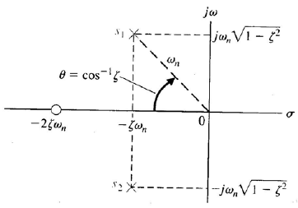
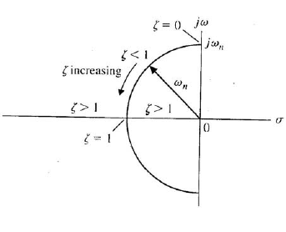
Spring mass damper system: Zero and poles plot
Plotting the poles and zeros for ω_{n}=1 and 0 < ζ< 1
No damping
Only imaginary poles
Angle θ to real axis given by
As damping increases point
pole rotates down onto real axis

Slide 35
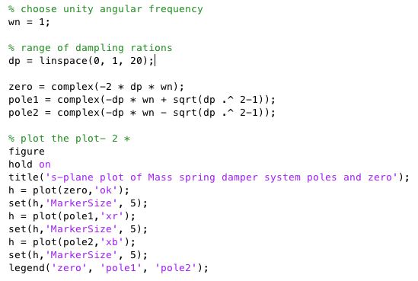
Spring mass damper system Matlab plot
Plotting the poles and zeros for ω_{n}=1 and 0 < ζ< 1

Slide 36
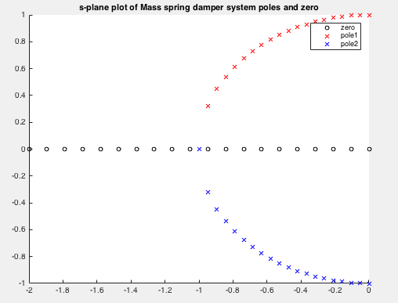
Spring mass damper system Matlab plot
Plotting the poles and zeros for ω_{n}=1 and 0 < ζ< 1

Slide 37
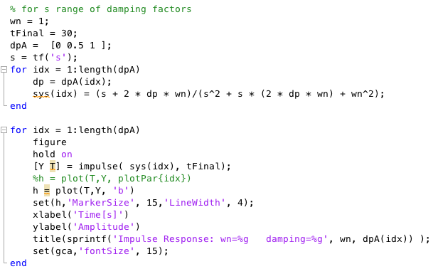
Plotting the impulse responses in Matlab

Slide 38
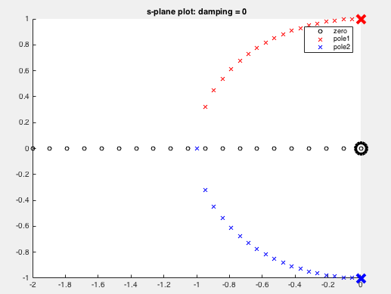
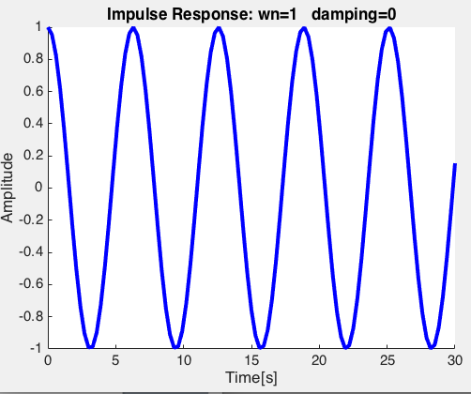
Spring mass damper system in Matlab
Highlighting poles and zero for damping = 0

Slide 39
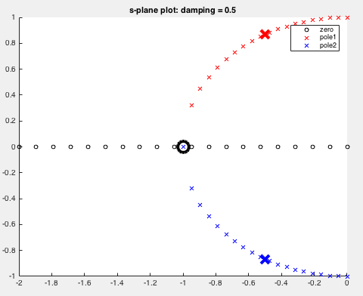
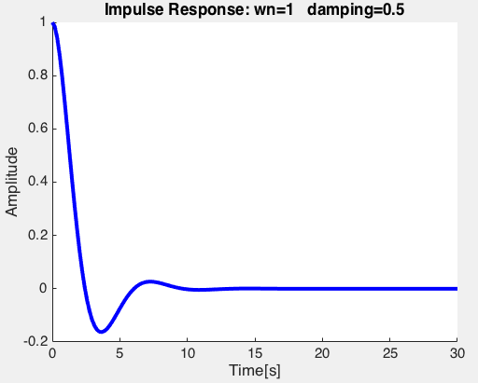
Spring mass damper system in Matlab
Highlighting poles and zero for damping = 0.5

Slide 40
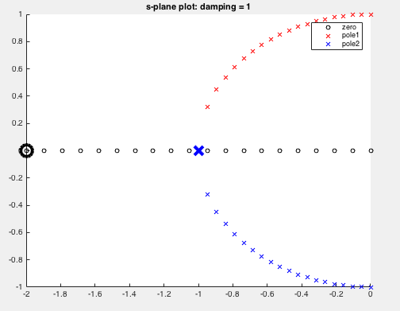
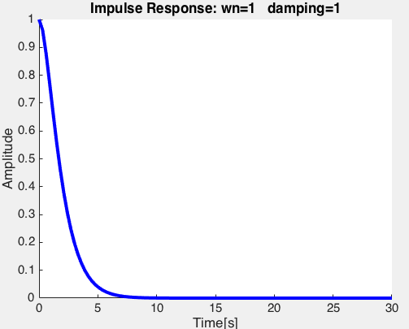
Spring mass damper system in Matlab
Highlighting poles and zero for damping = 1

Slide 41
Interlude 10 minute break

Slide 42
ROCO218: Control Engineering Dr Ian Howard Lecture 9 2nd order performance measures

Slide 43
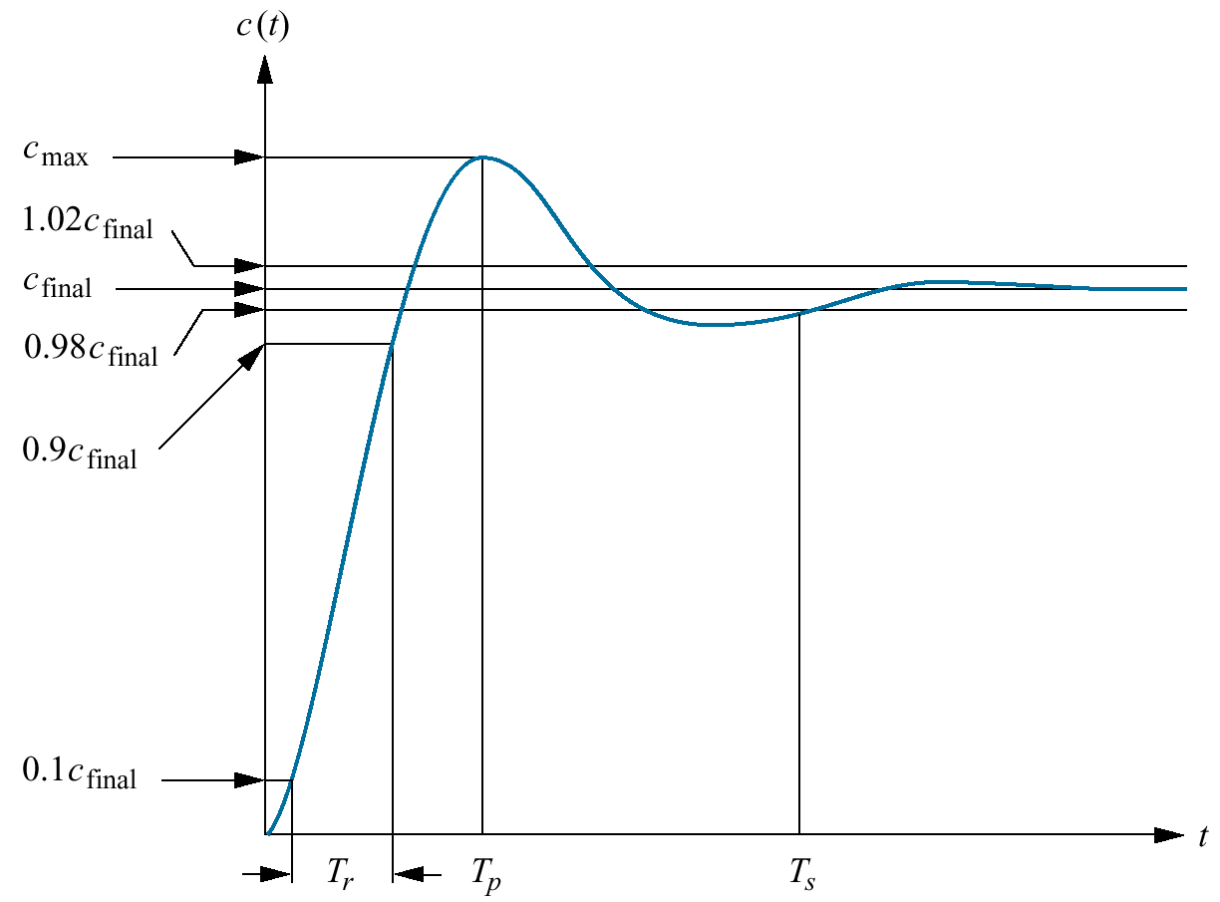
2nd order system: Rise time
Rise time T_{r} : It the time required for the response to rise from 10% to 90% of the final value.
Rise time

Slide 44
2nd order system: Peak time
Peak time T_{p} : It is the time required to reach the peak of the time response or peak overshoot.
T_{p} corresponds to half a cycle of damped oscillation w_{d}
Since
Peak time

Slide 45
2nd order system: Peak overshoot
Peak overshoot M_{p} : It indicates the difference between the peak and the steady output.
It occurs at the peak time
t = T_{p}
The maximum overshoot is determined by taking the time derivative of the time response and equating to zero
Can find time to maximum overshoot like this too.
Result is
Peak overshoot

Slide 46
2nd order system: Settling time
Settling time T_{s} : Time required for the response to reach and stay within a specified tolerance band (usually 2%) of its final value
Settling time
So

Slide 47
ROCO218: Control Engineering Lecture 9 ROCO218 2016R Exam examples Derive transfer function for electrical system

Slide 48
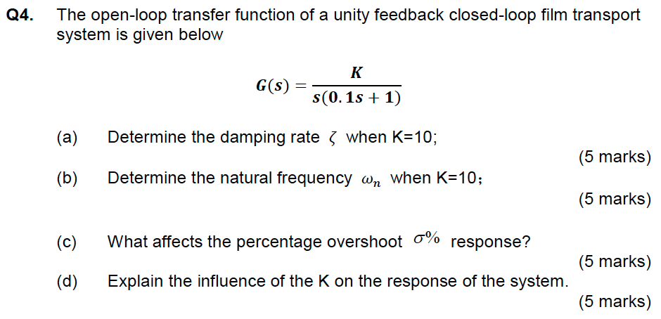
Q3: Canonical 2nd order form

Slide 49
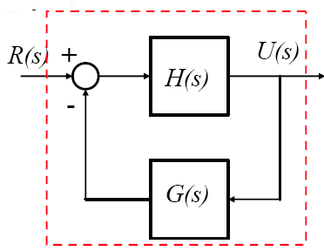
Q3: Canonical 2nd order form
The open loop function is
Remember
Therefore the unity feedback closed loop transfer function is
Substituting in K=10

Slide 50
Q3: Canonical 2nd order form
Comparing with canonical form
The percentage overshoot is given by
Matlab
100*exp(-0.5*pi/(sqrt(1-0.5^2)))
Peak time T_{p} of the step response
Matlab
pi/(10 * sqrt(1-0.5^2))
As K increases overshoot increases but peak time is not affected

Slide 51
ROCO218: Control Engineering Dr Ian Howard Lecture 9 Inversion

Slide 52
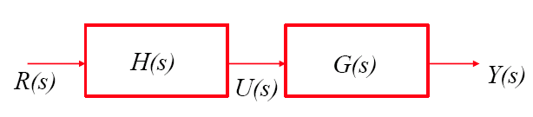
Control and inversion
In open loop control, the controller makes use of a model of the process without knowing how things are actually going
Consider the open loop system
Perfect servo control is achieved if Y(s)=R(s)
Thus controller need to have inverse transfer function of the plant

Slide 53
Control and inversion
The concept of plant inversion is very general in control
Perfect control requires open-loop inversion of the plant
Various ways to approximate it
Only possible if the model is perfect and there are no disturbances since open loop systems are also poor at rejecting disturbances
True inversion cannot be applied in practice
Relies on very accurate model
Also requires the plant and its inverse to be stable

Slide 54
Remember: Advantages of feedback
In closed-loop, the feedback depends on what actually happens, since it is the output of the plant
This will bring two benefits:
Reduced sensitivity to modeling errors
Reduced sensitivity to disturbances

Slide 55
Control and inversion
Consider feedback system
Note that for
High gain feedback implicitly generates the inverse of G(s)
It does so without us having to actually carry the inversion!

Slide 56
Trade-off
Although it seems that all is needed is high gain feedback, there is a cost attached to the use of high-gain feedback
When choosing the feedback gain, one must be conscious of the trade off between those various issues
This is the essence of control design
It will result in very large control actions
It increases the risk of instability
It increase the sensitivity to measurement noise

Slide 57
ROCO218: Control Engineering Dr Ian Howard Lecture 9 Steady state error

Slide 58
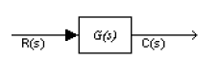
Steady state error: open loop
The steady state error (SSE) is the steady state value of the difference between the desired and the actual output of the control system
For the open loop system
Using the final value theorem of Laplace transforms
If the input R(s) is a step then
Where G(0) is the DC gain of the system

Slide 59
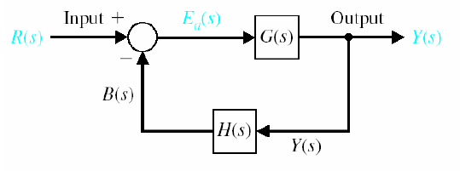
Steady state error: closed loop
For the closed loop system
Where T(s) is the closed loop transfer function
If H(s) = 1
If the input R(s) is a step then

Slide 60
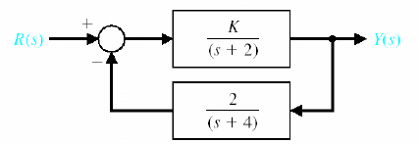
Steady state error example 1
Closed loop transfer function T(s) is given by
G(s)
H(s)

Slide 61
Steady state error example 1
So given
and
If the input is a step then R(s)= 1/s so
If SSE = 0 then
Therefore SSE=0 iff K=4

Slide 62
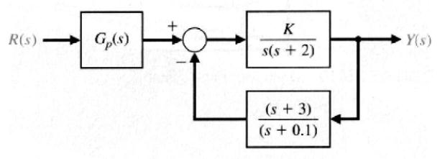
Steady state error example 2
A feedback system with an input amplifier G_{p}(s) is shown above
Determine the steady state error for a unit step input when K = 0.4 and G_{p}(s) = 1.
b) Select an appropriate constant value for G_{p}(s) so that the steady state error is zero for a unit step input and K = 0.4.

Slide 63
Steady state error example 2
Writing down transfer function
T(s) = Y(s)/R(s)

Slide 64
Steady state error example 2
Determine the steady state error for a unit step input when K = 0.4 and G_{p}(s) = 1
We know error E(s) is given by
So steady state error is
So steady state error for a unit step is

Slide 65
Steady state error example 2
Select an appropriate constant value for G_{p}(s) so that the steady state error is zero for a unit step input and K = 0.4.
So steady state error for a unit step is now
We require
Therefore
So error condition fulfilled if

